Slide 1
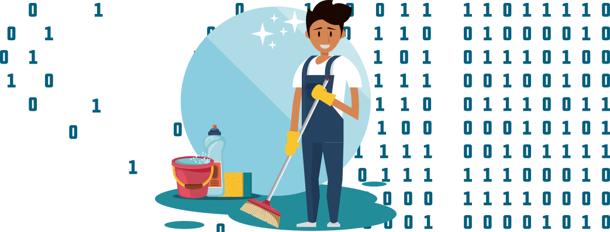
Data Transformation, Tidying, and Wrangling
Notes:
Goal of why long why wide

Slide 2
Why do we care?
Cleaning your data can take a LONG time
You can and should use R / R-studio to wrangle your data
Doing so manually is prone to human error
Using R code helps you keep track of everything you have accomplished
Allows for easier replicability

Slide 3
Case Study
You’re a new Ph.D. student and at your first lab meeting, your PI wants to get you involved in working with data right away. They send you 15 separate excel sheets containing 4 weeks worth of behavioral speech language therapy data, one sheet for each subject. For next week’s lab meeting, they ask if you can come with an aggregated master data set “in long form.” Without seeing the data you think to yourself “I don’t know what exactly they want but this will be no problem. I can use this as an opportunity to learn R, ask my amazing Pitt CSD PhD cohort for help, and Google things when I’m unsure.”

Slide 4
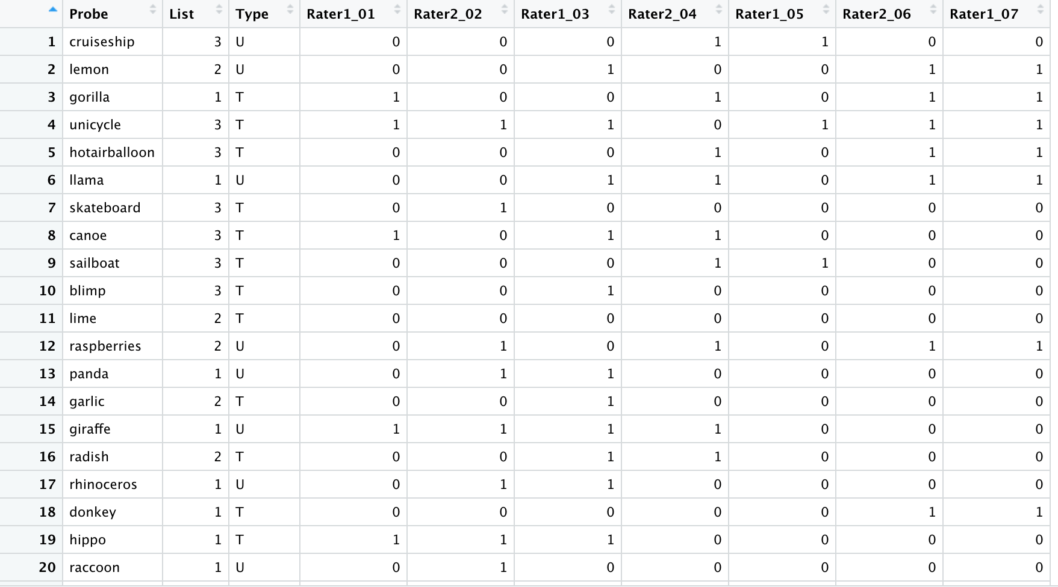
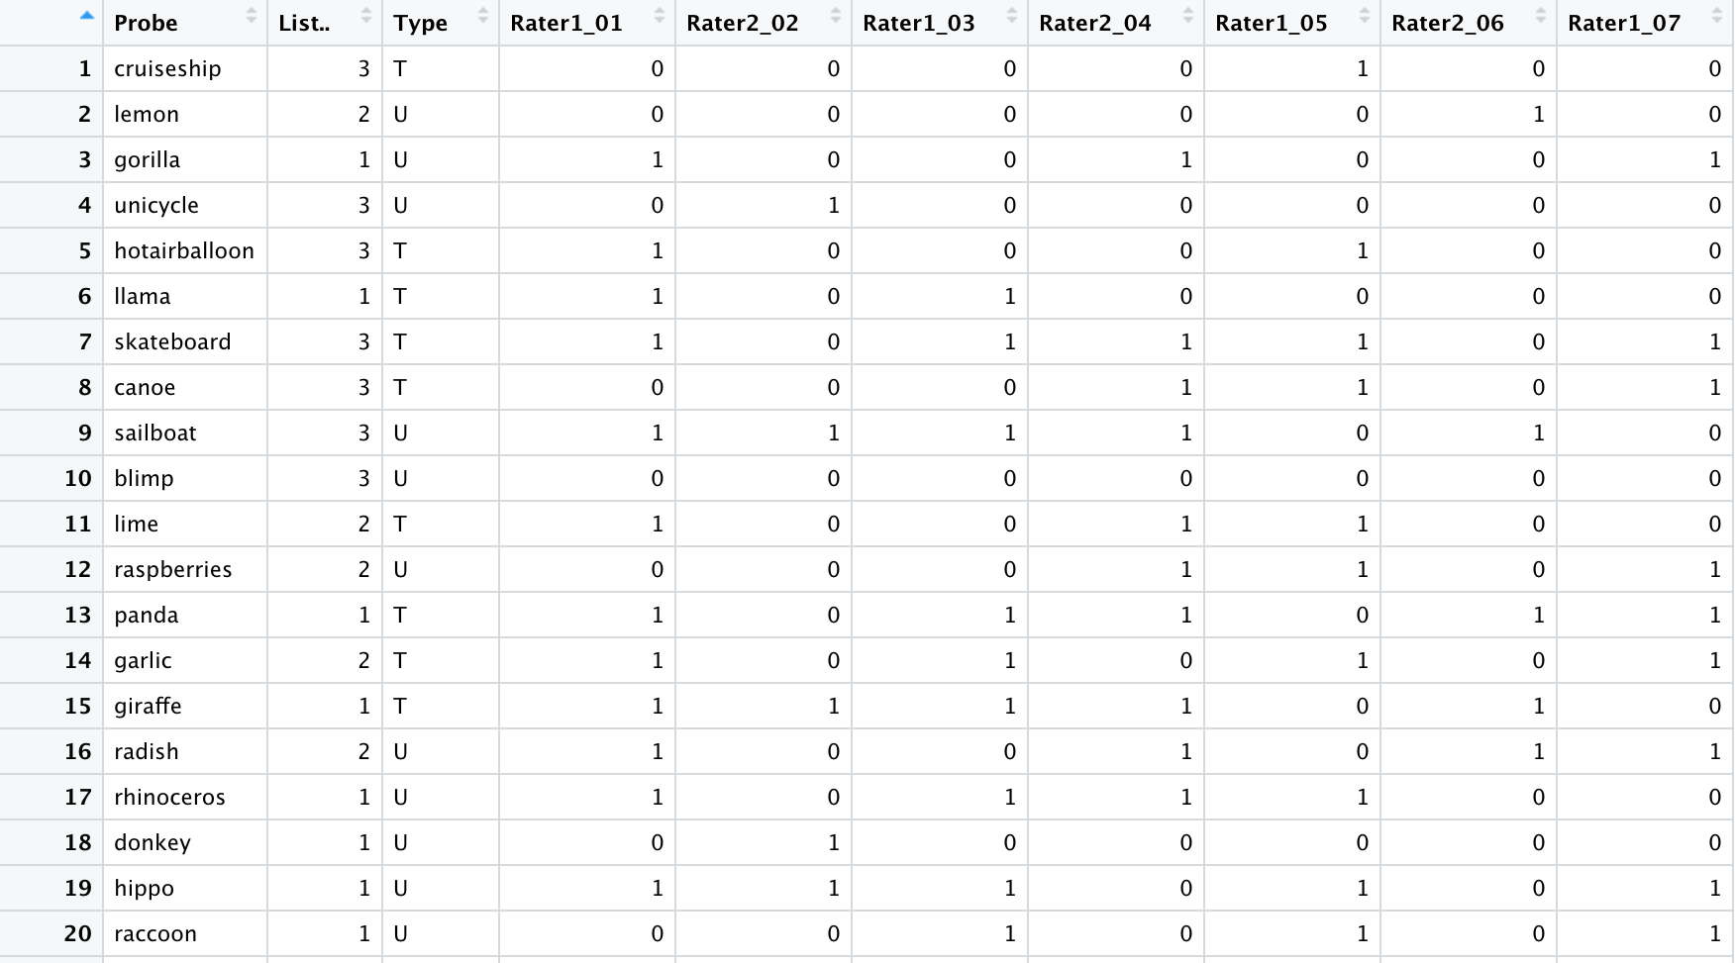
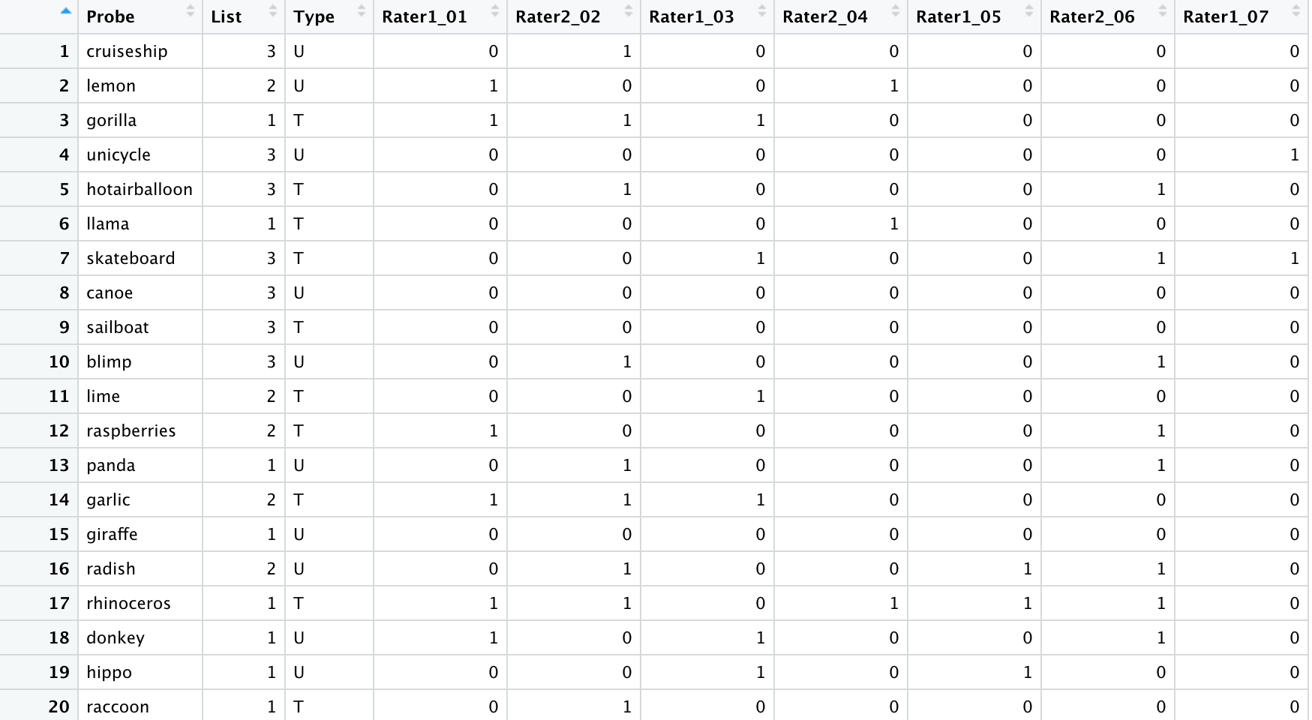
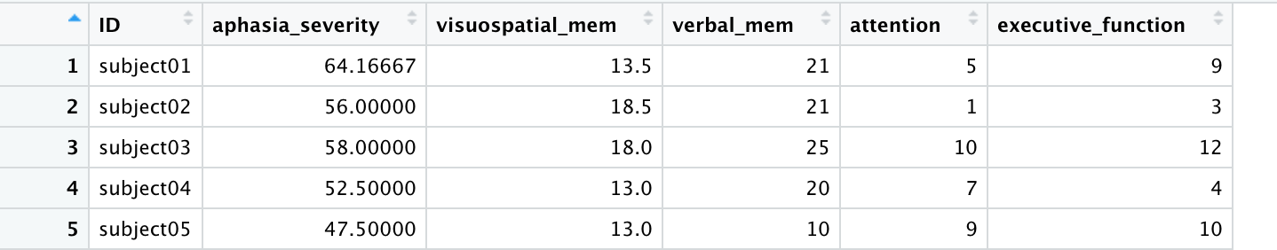
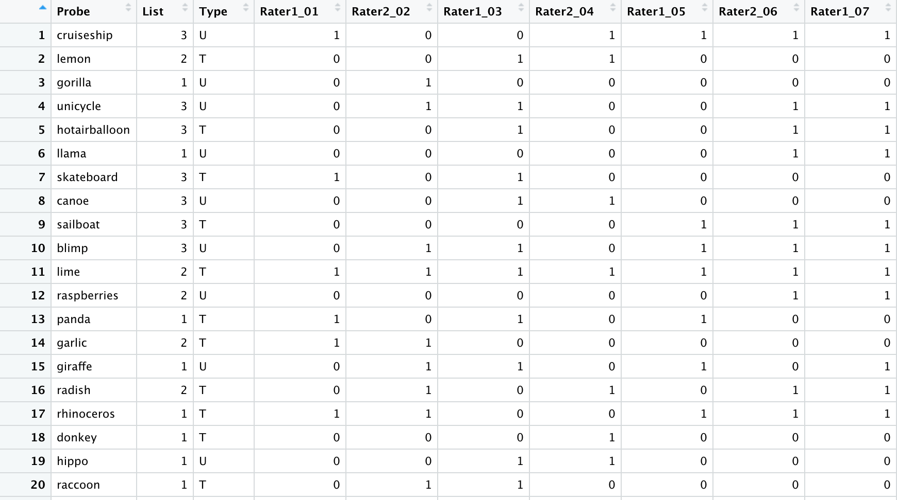
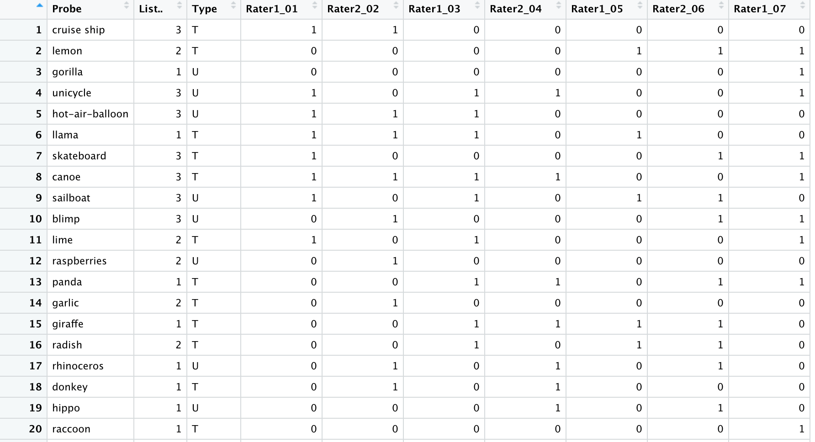

Slide 5
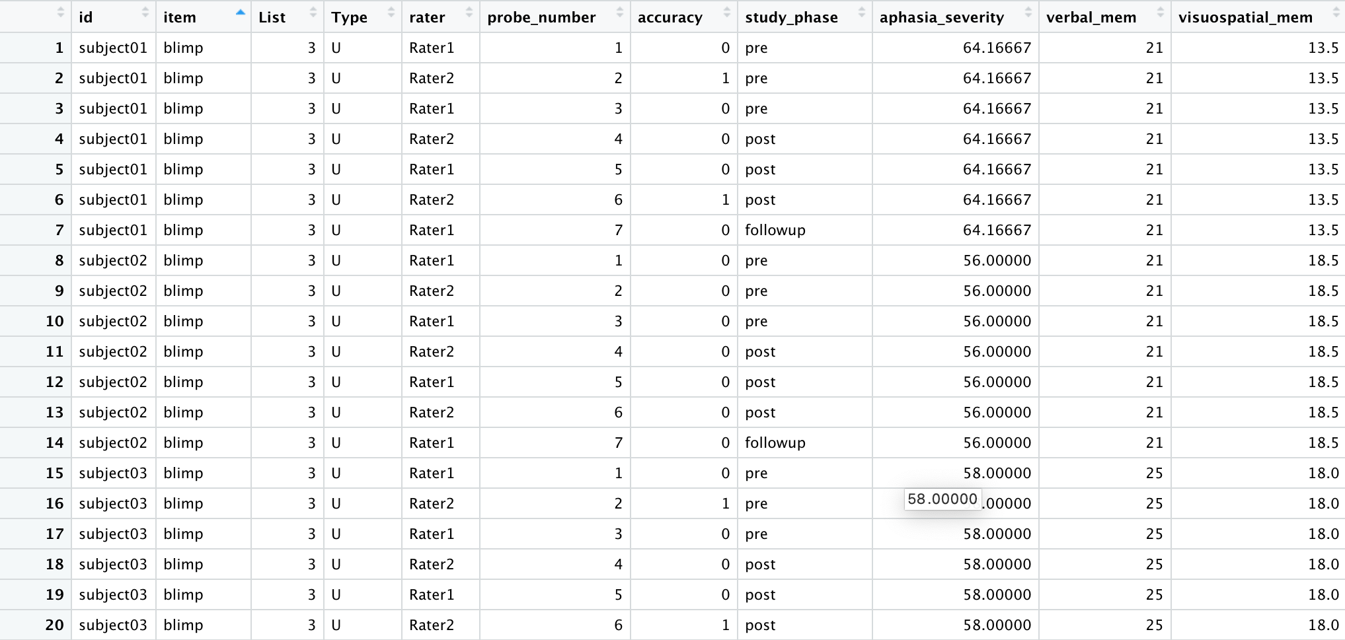

Slide 6
Learning Objectives
1. Understand the value in pre-processing data using R.
2. List examples of errors and architectural flaws that may exist within a given raw data set, reason why those errors/flaws may be detrimental to the analytic process, and generate solutions for addressing them.
3. Learn how to use several commands from the tidyverse library.
4. Implement basic R commands learned in previous lessons of this workshop.
5. Follow a set of instructions using `tidyverse` based commands to transform the data into a ready-to-analyze set.
6. Generate solutions to specific problems focused on data tidying, cleansing, and transformation.

Slide 7
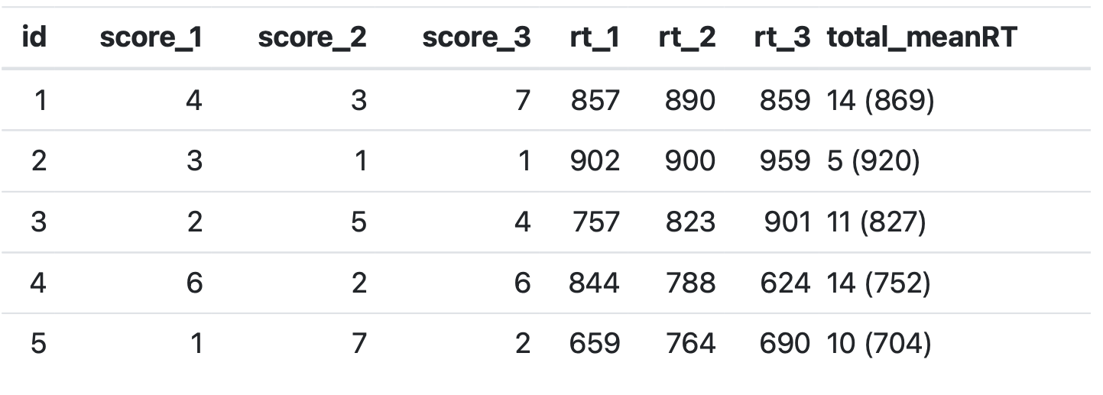
Dirty Data

Slide 8
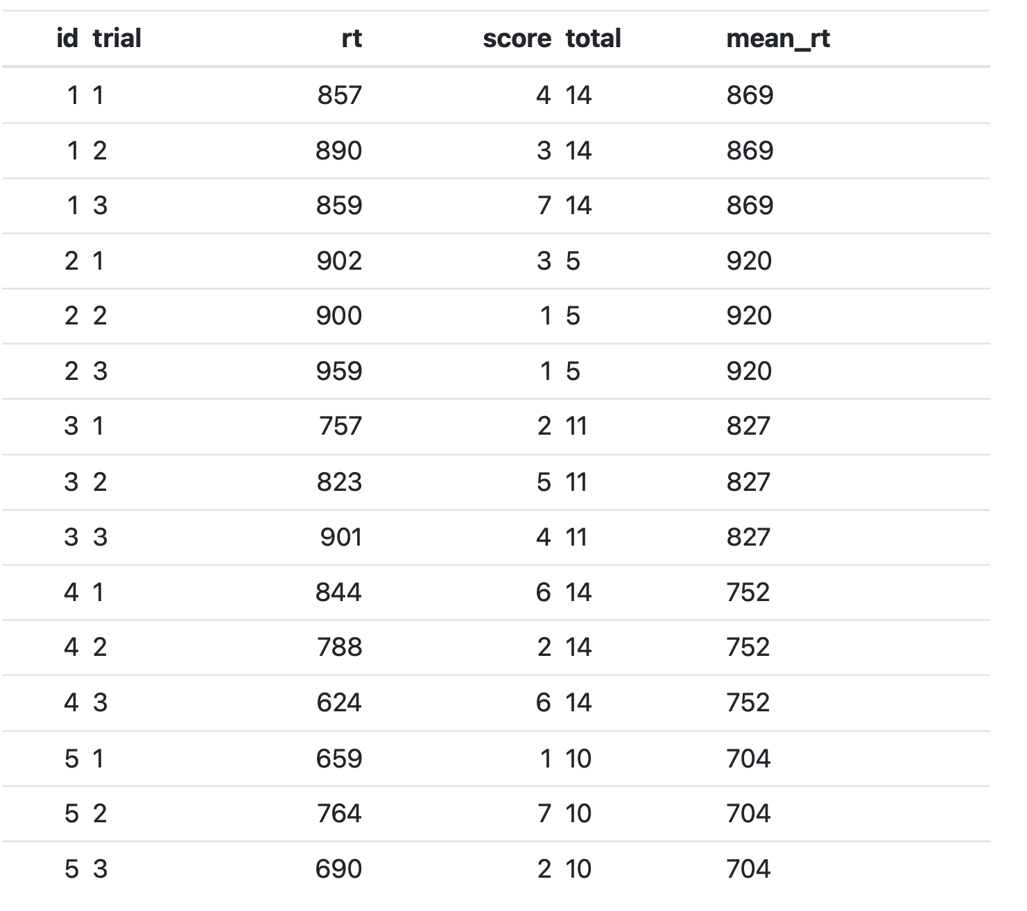
Tidy Data

Slide 9
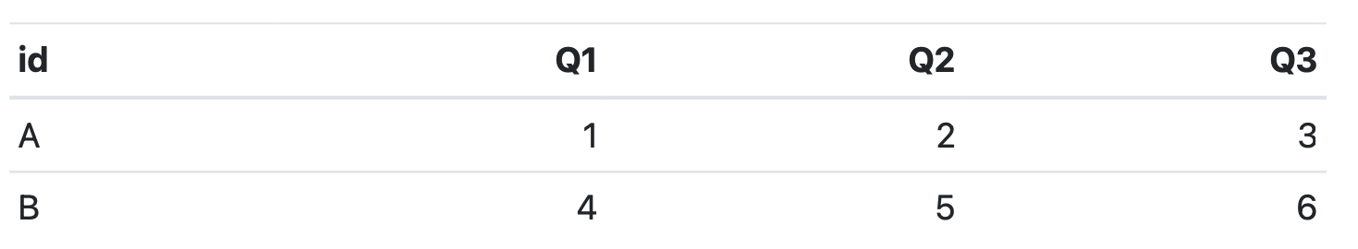
Wide Data

Slide 10
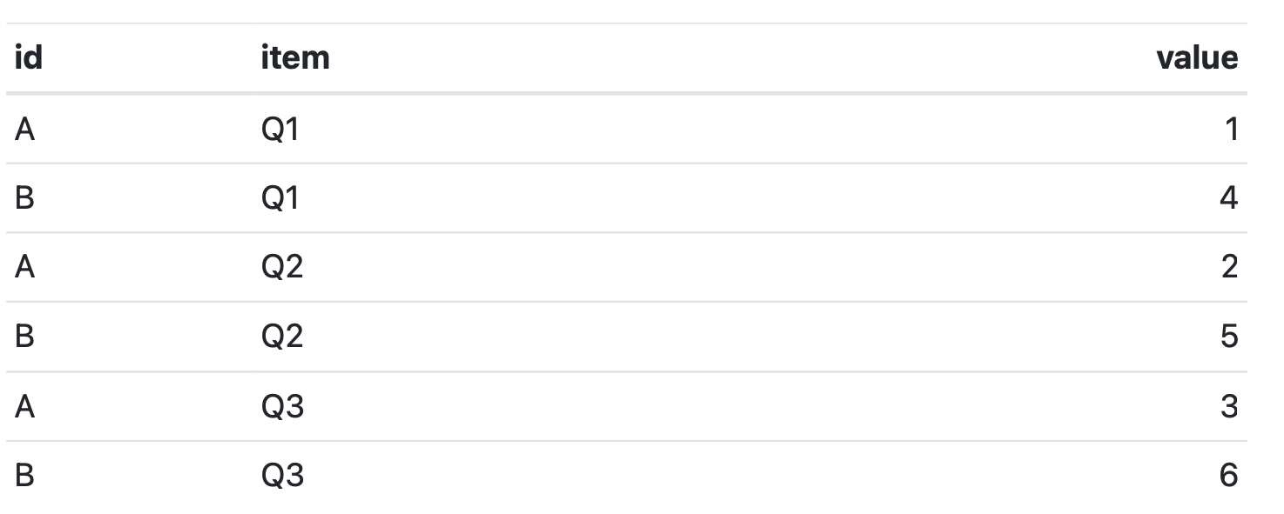
Long Data

